Slide 1
Hong Kong Convention and Exhibition Center
Hong Kong, 30-31 Oct. 2023
How Textile Industry Mingle with NonWovens
 | Prof. HU Jinlian
Department of Biomedical Engineering
Laboratory of Wearable Materials for Healthcare

Slide 2
Hong Kong Convention and Exhibition Center
Hong Kong, 30-31 Oct. 2023
How Textile Industry Mingle with Non-Woven
 | Prof. HU Jinlian
Department of Biomedical Engineering
Laboratory of Wearable Materials for Healthcare

Slide 3
Contents
Nonwovens in Apparel and Textiles
Advantages of Nonwovens
Cost effectiveness of Nonwoven
Versatility of Nonwoven Technologies
History of Nonwovens and electrospinning
Versatility of Electrospun NonWoven
Electrospinning and Applications
Functional Nonwovens in Textiles
Cconclusions

Slide 4
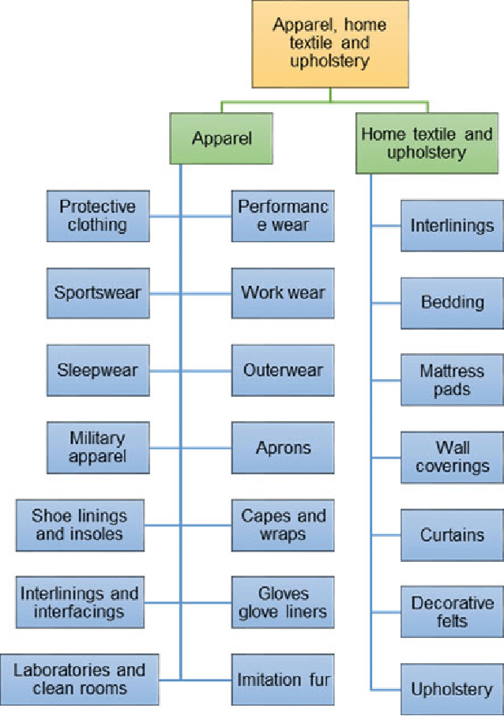
Nonwovens in Apparel and Textiles

Slide 5
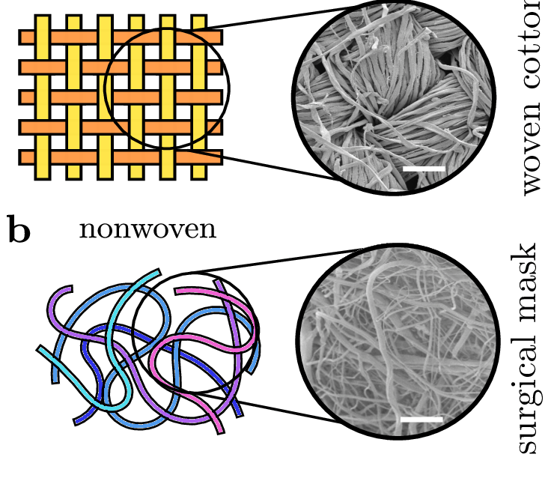
Advantages of Nonwovens
Versatility
Continuous web, without yarn structure
Lightweight nature
Breathable
Absorbent
Liquid repellent
Soft, resilient
Stretchable
Disposable
Cushioning
Filtering
Bacterial barrier and sterility
High productivity
Cost-effectiveness

Slide 6
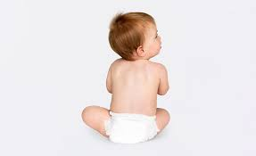
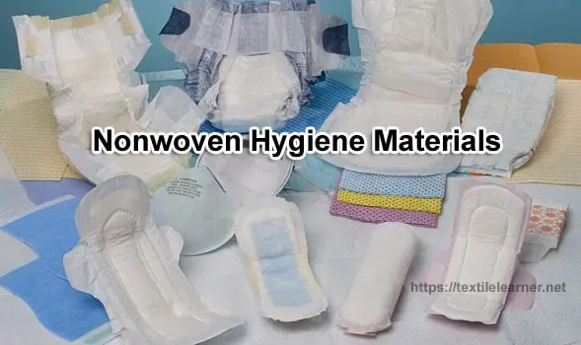
Bringing Convenience, Happiness and Success---Significant

Slide 7
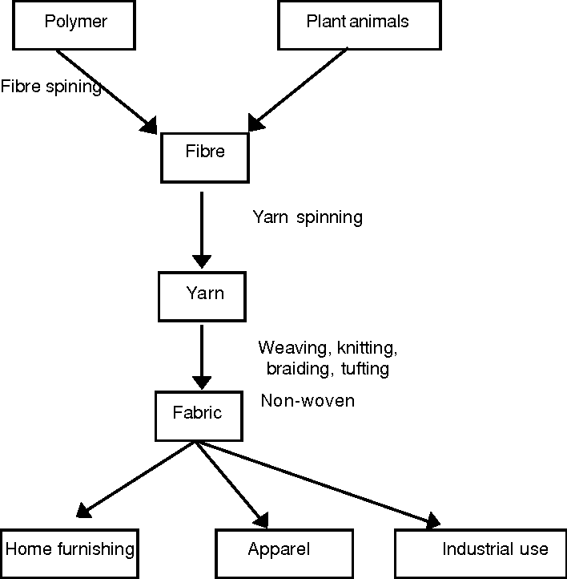
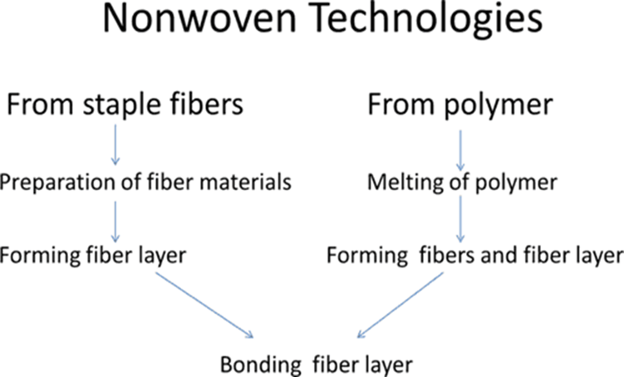
Cost effectiveness of Nonwoven

Slide 8
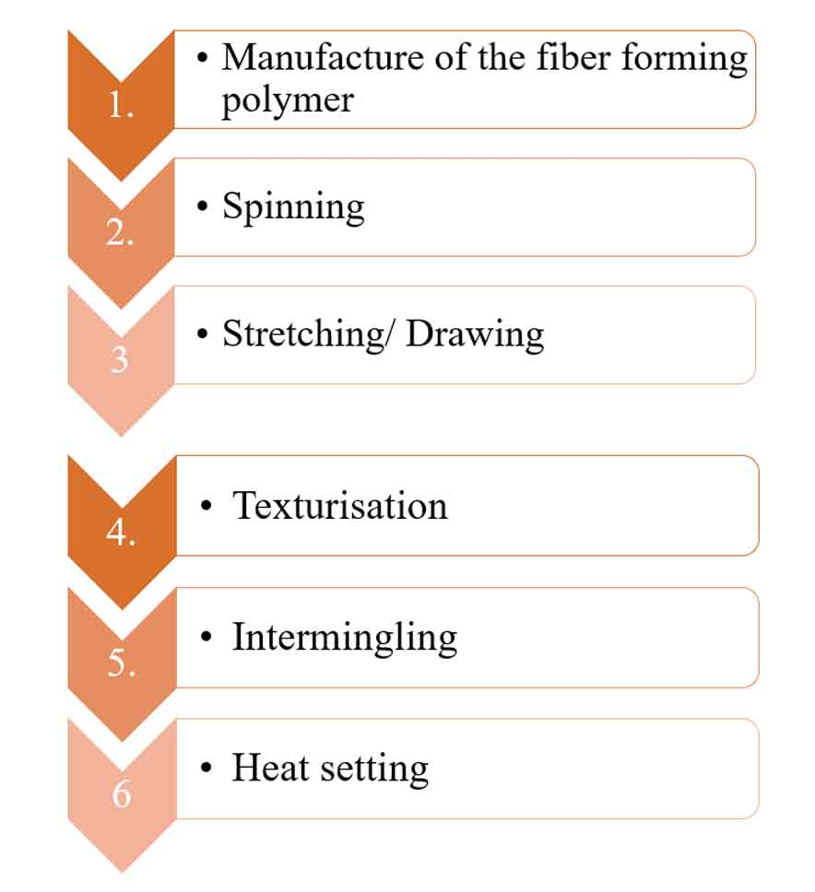
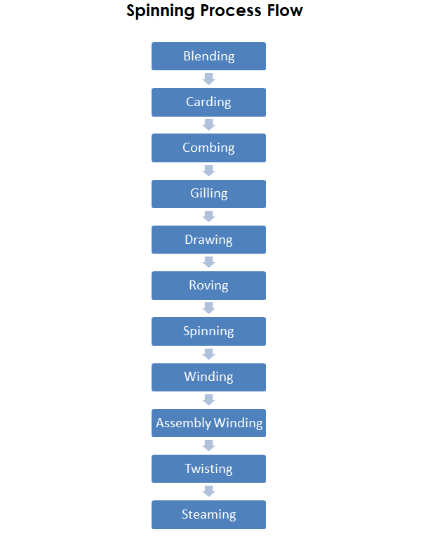
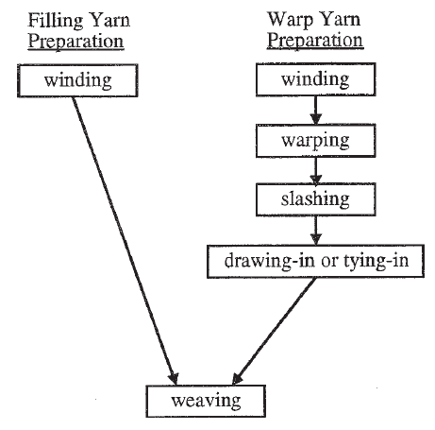
Cost effectiveness of Nonwoven
Fibre Spinning
Yarn Spinning
Weaving Preparation

Slide 9
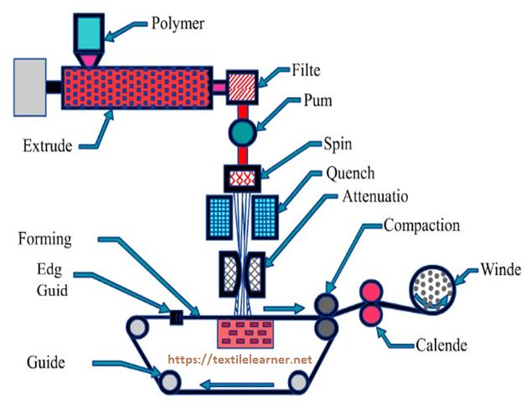
Non-woven: from Polymer to Fabrics
Process is so short and the speed is very high
SS: Production speed up to 450 m/min

Slide 10
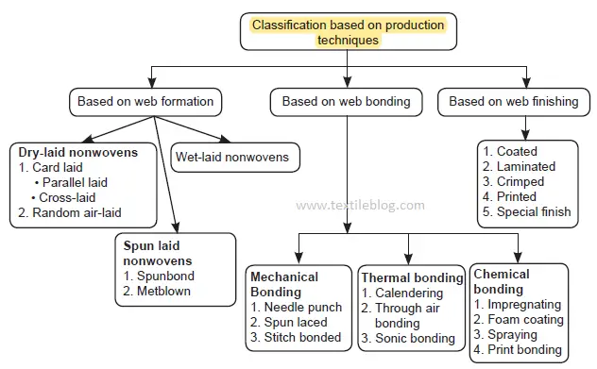
Versatility of NonWoven Technologies

Slide 11
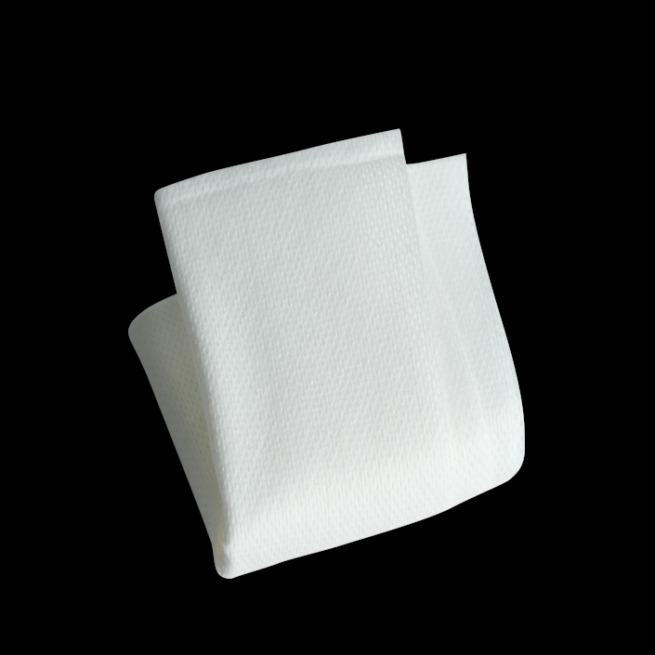
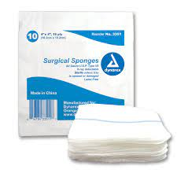
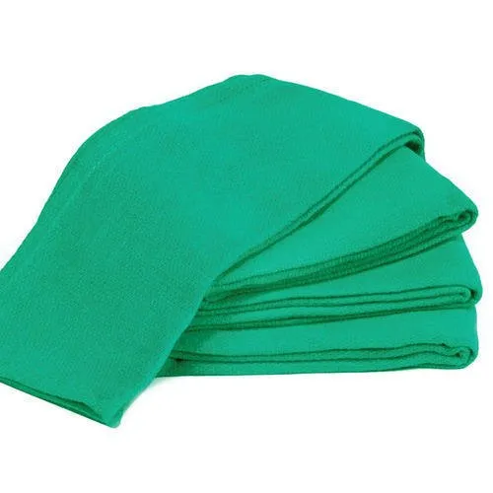
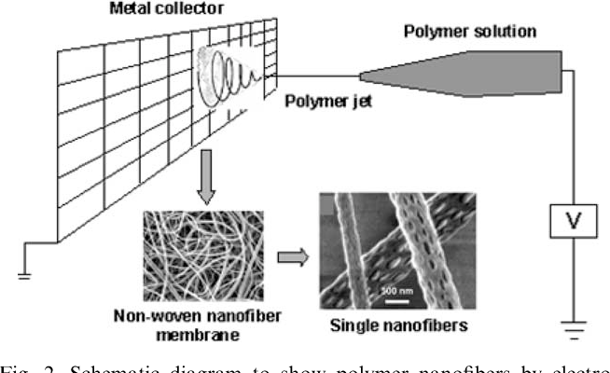
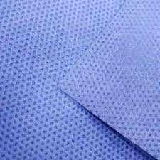
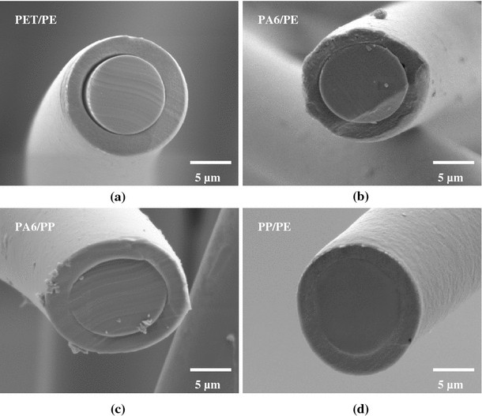
History of Nonwovens
Freudenberg and DuPont developed enhancing technology in spunbond
Bicomponent fibers were developed in meltblown and spunbonded nonwovens
Electrospinning
1950s
1990s
1920s-
1930s
1970s
Water-jet technology was developed for surgical gauze
Nano-fibers
Chicopee
Manufacturing
Corp developed Viscose rayon
Products, for hygiene uses.

Slide 12
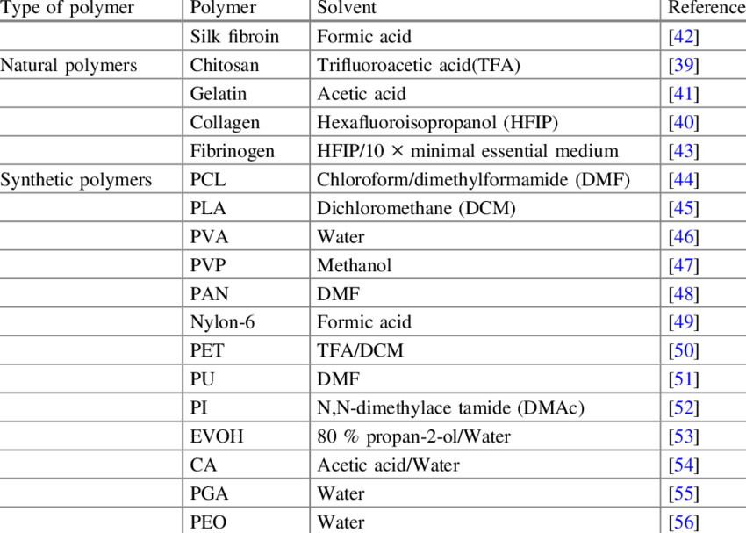
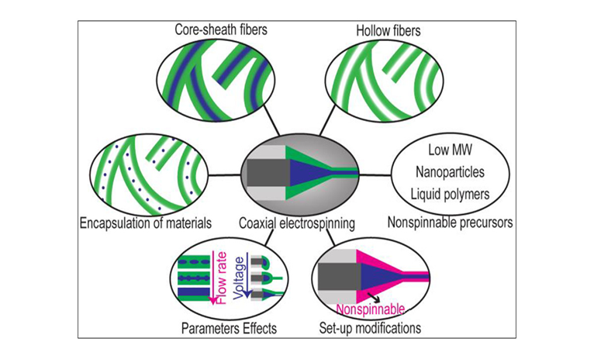
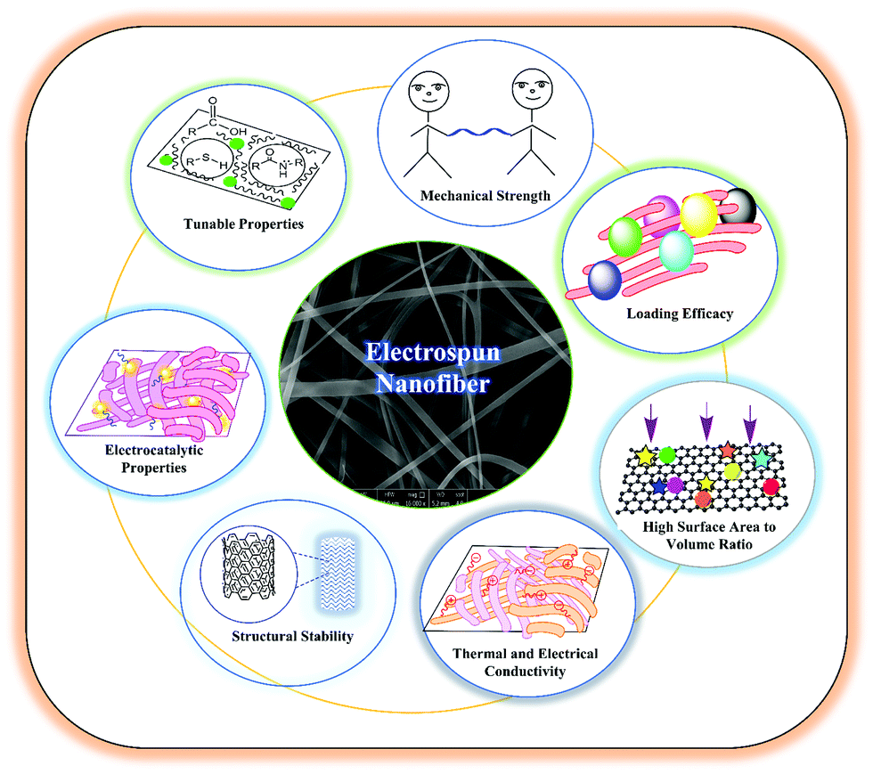
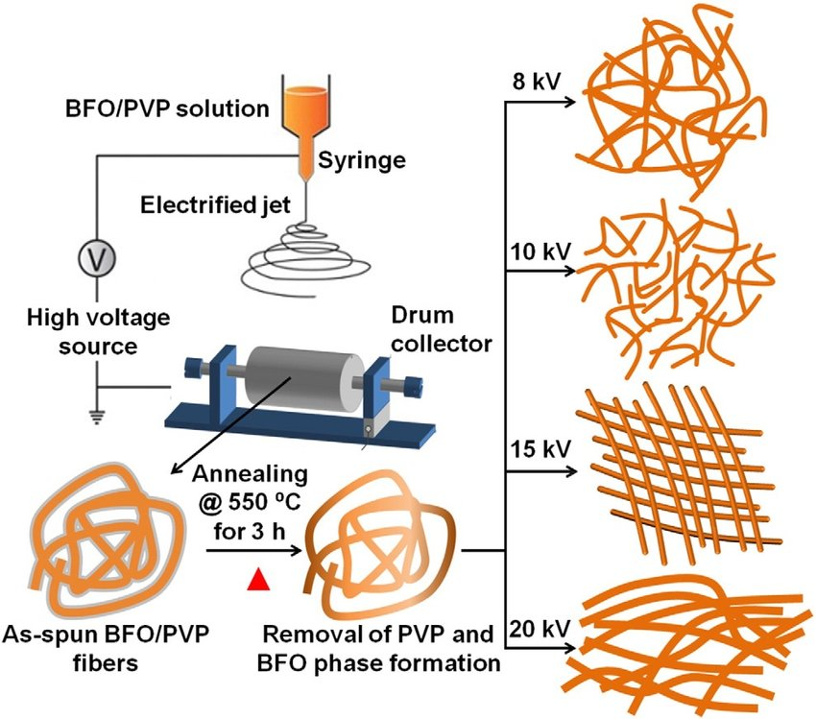
Versatility of Electrospun NonWoven

Slide 13
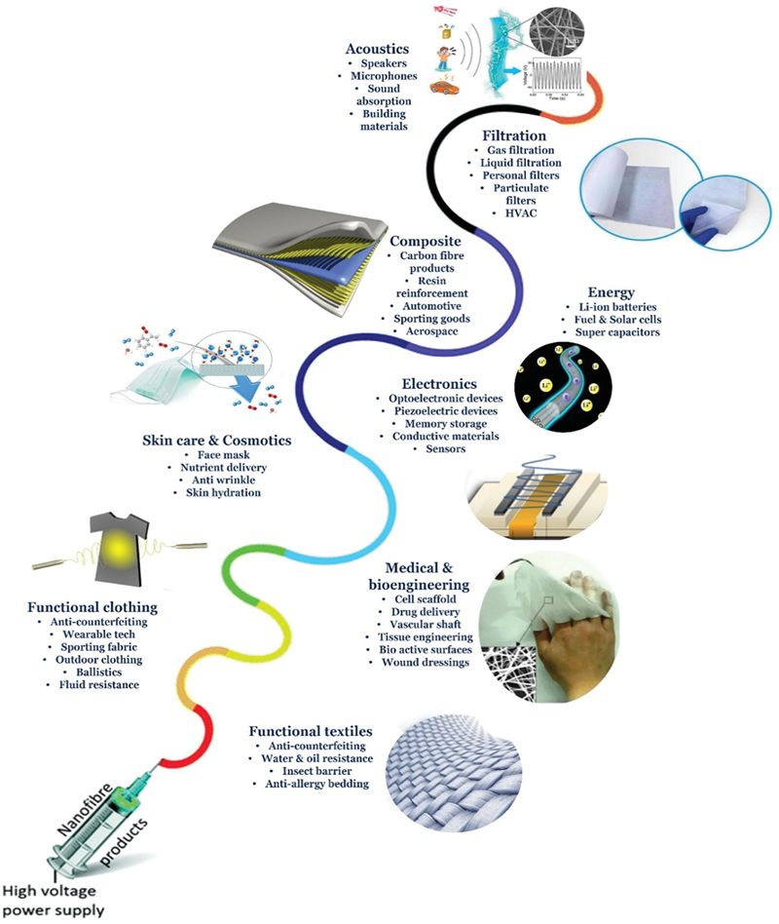
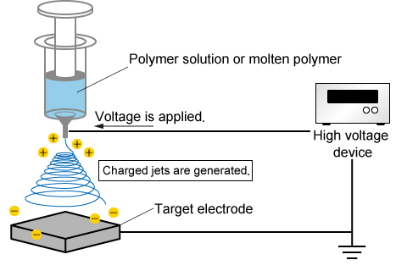
Electrospinning and Applications
Electrospinning

Slide 14
Advanced Functional Nonwovens in Textiles and Apparel
Thermoregulatory textiles
Wearable Sensing Devices
Functional Filtration Systems
Protective Clothing
Hygiene and Biomedical Textiles
Notes:
10.1007/s40820-023-01028-2
https://doi.org/10.1002/smll.202304705
https://doi.org/10.1021/acsnano.3c02099

Slide 15
Thermoregulatory Textiles

Slide 16
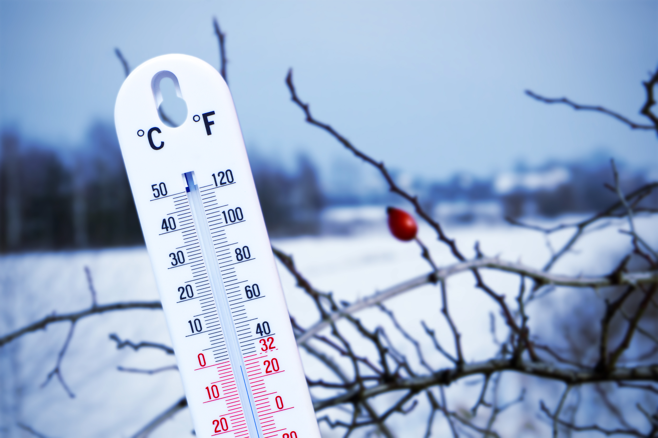
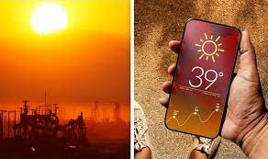
Body Heat: Input, Output and Pphysiological Responses
Heat transfer pathway between the human body and outer environment as well as adverse physiological responses to variations in core body temperature; Metabolic heat and solar absorption are two heat input mechanisms. Output channels include conduction, convection, radiation, and evaporation.

Slide 17
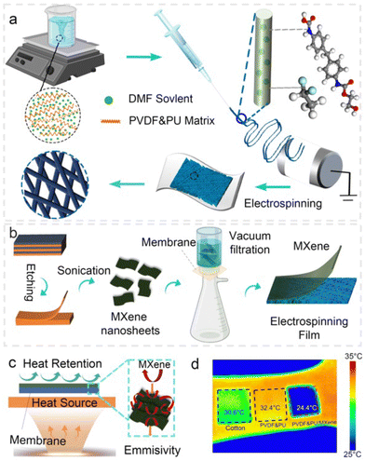
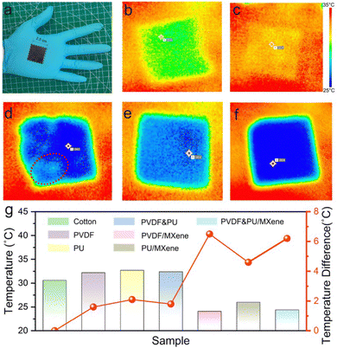
Low-emissivity passive heating membrane with warmth retention for Thermoregulatory textiles-Warming
A supramolecular-enhanced membrane (SupraEM) acting as a mid-infrared (MIR) reflector to solve the conundrum of warmth-wearability performance.
https://doi.org/10.1039/D3MH00768E

Slide 18
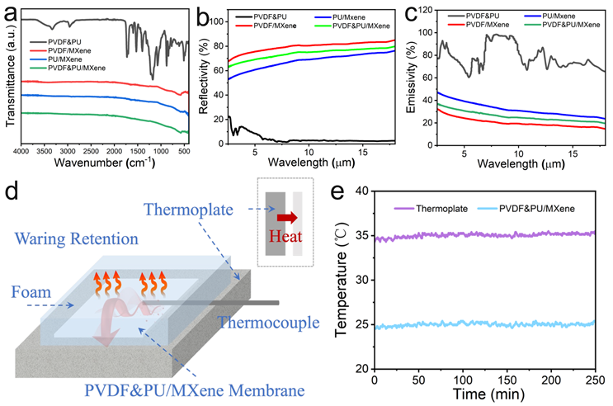
Infrared spectroscopy Spectra
(b) Reflectivity, and
(c) Emissivity of PVDF&PU, PVDF/MXene, PU/MXene, and PVDF&PU/MXene.
(d) Schematic diagram of the heating platform experiment, with the heat transfer direction.
(e) Real-time temperature record of PVDF&PU/MXene at 35 °C.

Slide 19
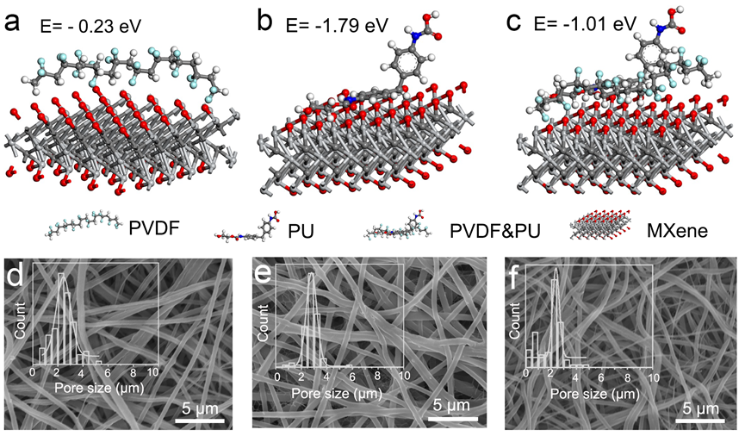
Mechanism of SUPRAEMs
The optimized configurations of (a) PVDF/MXene, (b)PU/MXene, and
(c) PVDF&PU/MXene during the process of mutual absorption. SEM images and insert pore size distribution of polymers (d) PVDF, (e) PU, and (f) PVDF&PU.

Slide 20
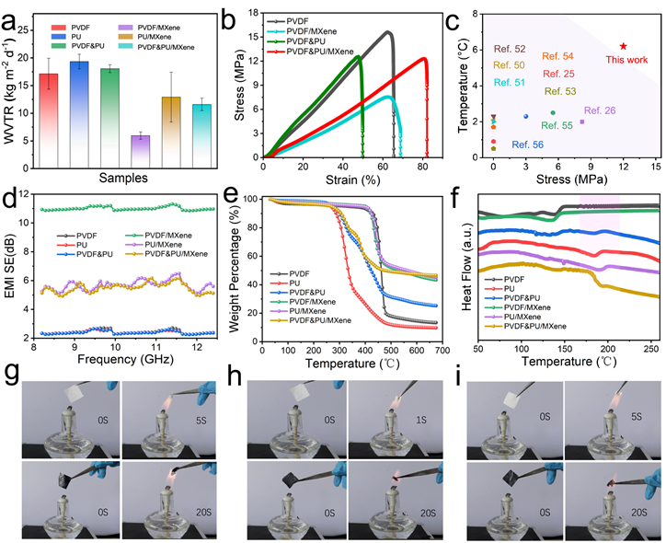
Performances of SupraEMs
Water vapor transmission rate
Strain-stress curves
Comparison of the maximum temperature difference and maximum withstanding strength with other reported studies.
EMI curves.
TGA curves
DSC curves. Photograph of the combustion process
PVDF and (PVDF/MXene,
PU and PU/Mxene
PVDF&PU and PVDF&PU/MXene.

Slide 21
Evaporative/radiative electrospun membrane for personal cooling

Slide 22
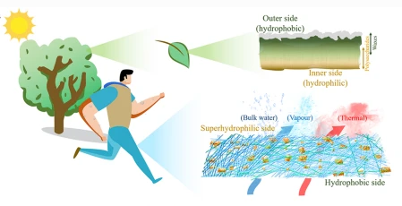
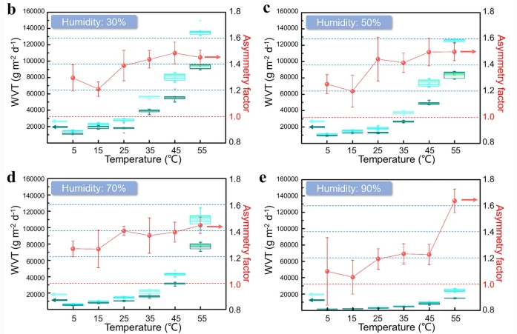
Thermoregulatory textiles：
Single-Layer Janus Fabric with Directional Water Transport for Integrated Personal Cooling Management
A Janus Nonwovens for directional water transport property and cooling management
10.1007/s42765-022-00200-4

Slide 23
Wearable Electronics

Slide 24
Directional Moisture-Wicking Electronic Skins for Biomechanical Energy Harvesting and
All-Range Health Sensing
Wearable devices developed from PVDF electrospun nonwovens, integrating moisture-wicking effect and static signal sensing. It can monitor walking, speaking, pulsing.
10.1007/s40820-023-01028-2

Slide 25
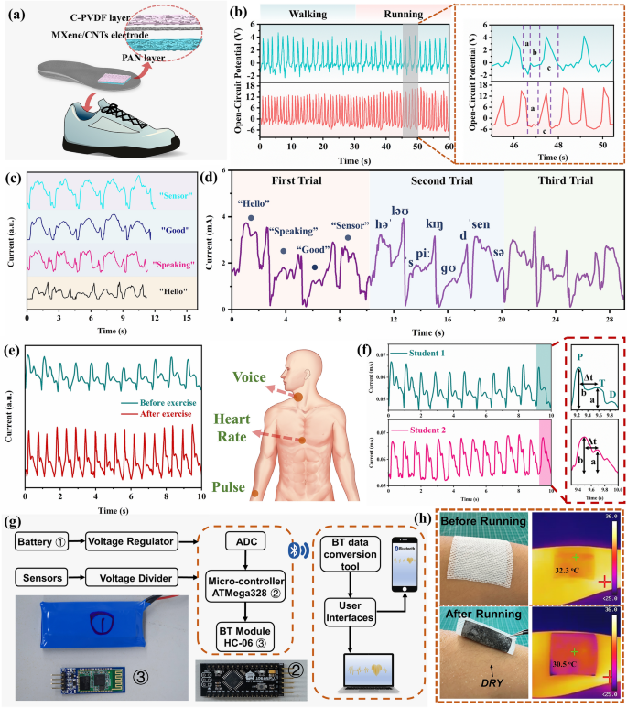
Directional Moisture-Wicking Electronic Skins for Biomechanical Energy Harvesting and All-Range Health Sensing
Wearable devices developed from PVDF electrospun nonwovens, integrating moisture-wicking effect and static signal sensing. It can monitor walking, speaking, pulsing.
10.1007/s40820-023-01028-2

Slide 26
A Bionic Skin for Health Management Excellent Breathability, In Situ Sensing, and Big Data Analysis

Slide 27
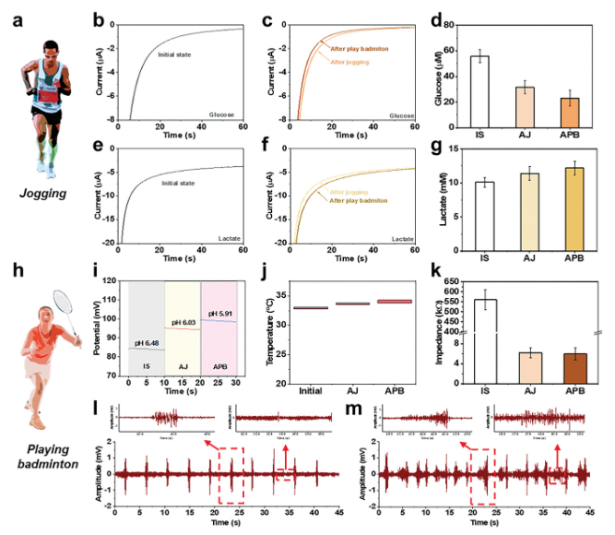
A Bionic Skin for Health Management
Excellent Breathability, In Situ Sensing, and Big Data Analysis
Wearable devices developed from PVDF electropunk nonwovens, integrating moisture-wicking effect and static signal sensing. It can monitor walking, speaking, pulsing.
https://doi.org/10.1002/adma.202306435

Slide 28
A Bionic Skin for Health Management
Excellent Breathability, In Situ Sensing, and Big Data Analysis
Wearable devices developed from PVDF electropunk nonwovens, integrating moisture-wicking effect and static signal sensing. It can monitor walking, speaking, pulsing.
https://doi.org/10.1002/adma.202306435

Slide 29
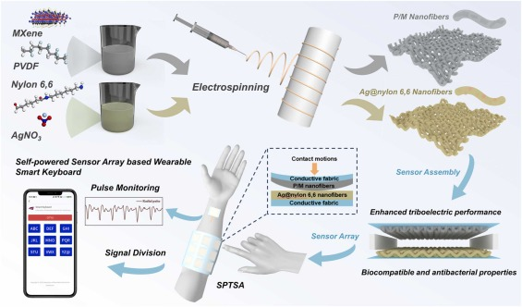
A biocompatible and antibacterial all-textile structured triboelectric nanogenerator
for self-powered tactile sensing
Anti-bacterial and self-powering nonwovens
https://doi.org/10.1016/j.nanoen.2023.108734

Slide 30
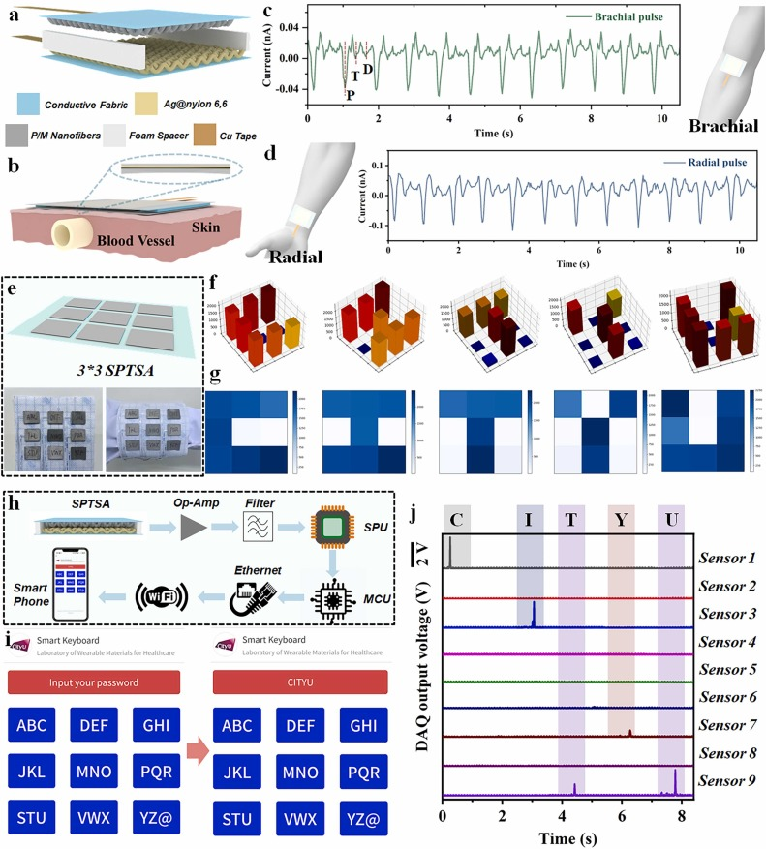
A biocompatible and antibacterial all-textile structured triboelectric nanogenerator
for self-powered tactile sensing
Anti-bacterial and self-powering nonwovens
https://doi.org/10.1016/j.nanoen.2023.108734

Slide 31
A biocompatible and antibacterial all-textile structured triboelectric nanogenerator
for self-powered tactile sensing
Anti-bacterial and self-powering nonwovens
https://doi.org/10.1016/j.nanoen.2023.108734

Slide 32
Functional Filtration System

Slide 33
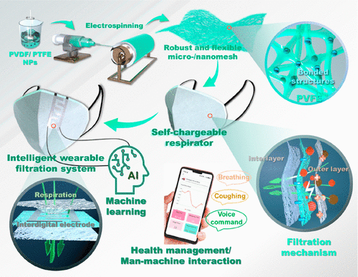
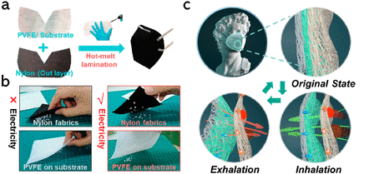
An Intelligent Wearable Filtration System for Health Management
Multifunctional face mask with high filtration efficiency and signal-sensing ability.
https://doi.org/10.1021/acsnano.3c02099

Slide 34
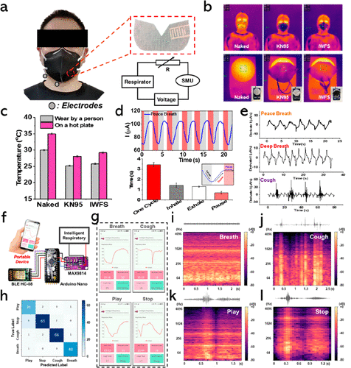
An Intelligent Wearable Filtration System for Health Management
Multifunctional face mask with high filtration efficiency and signal-sensing ability.
https://doi.org/10.1021/acsnano.3c02099

Slide 35
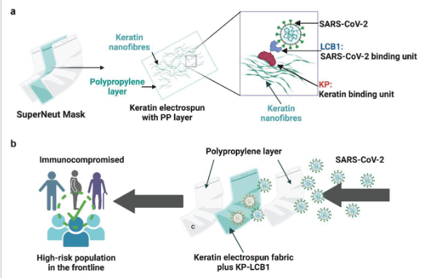
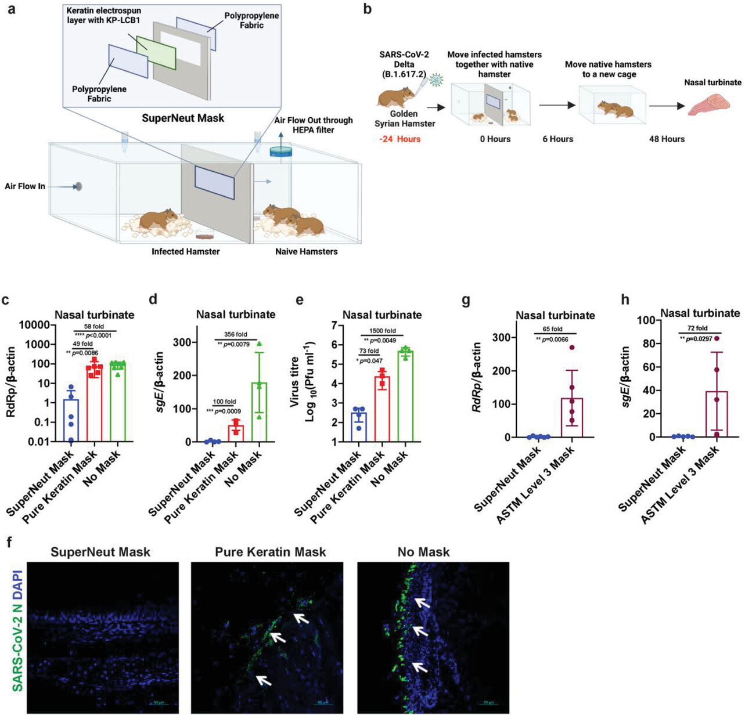
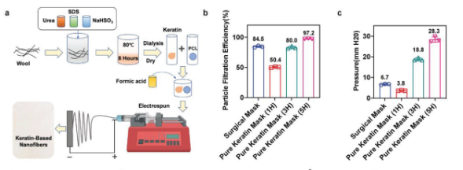
Protein-Based Face Mask with
High SARS-CoV-2 Neutralization Ability and Breathability
Electrospun protein-based masks for anti-COVID-19 virus.
https://doi.org/10.1002/admt.202300590

Slide 36
Protective Clothing

Slide 37
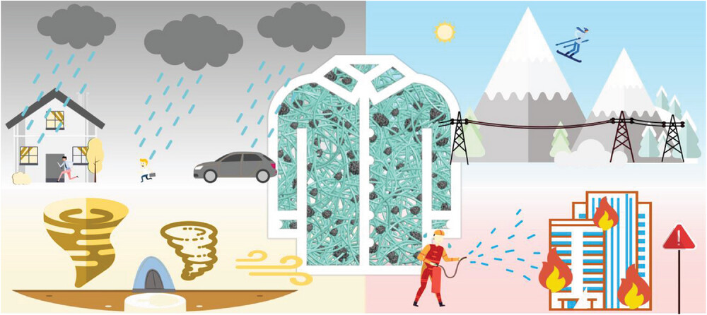
Bioinspired Hierarchical Multi-Protective Membrane for
Extreme Environments via Co-Electrospinning-Electrospray Strategy
Nonwovens from electrospun and electrospray technologies for protective clothing. It is breathable and fire-retardant.
https://doi.org/10.1002/smll.202304705

Slide 38
Bioinspired Hierarchical Multi-Protective Membrane for
Extreme Environments via Co-Electrospinning-Electrospray Strategy

Slide 41
Others

Slide 42
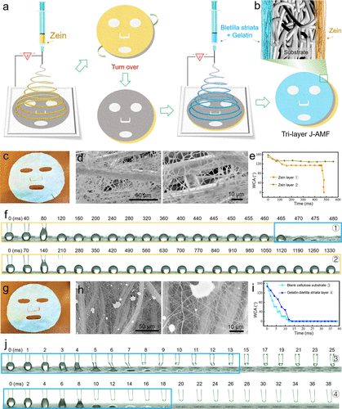
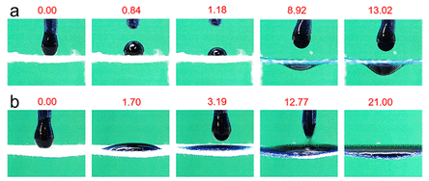
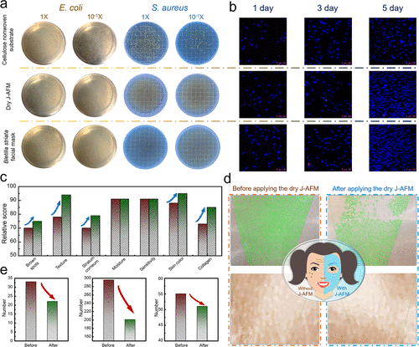
Electrospinning Membranes with Directional Water Transport as
Ecofriendly Dry Facial Masks
Janus facial mask with directional water transport properties.
Advanced Materials Technologies, DOI: (10.1002/admt.201600015)

Slide 43
A skin-like nanostructured membrane for advanced wound dressing

Slide 44
A skin-like nanostructured membrane for advanced wound dressing

Slide 45
Conclusions
Nonwovens are versatile and cost-effective technologies compared with traditional woven and knitted fabrics.
Nonwovens have huge applications in Apparel and textiles
Electrospun nonwovens are becoming feasible and provide huge opportunities
Nonwovens now can be modified with advanced and multiple functions to meet new and challenging textiles and apparel requirements by electrospinning

Slide 46
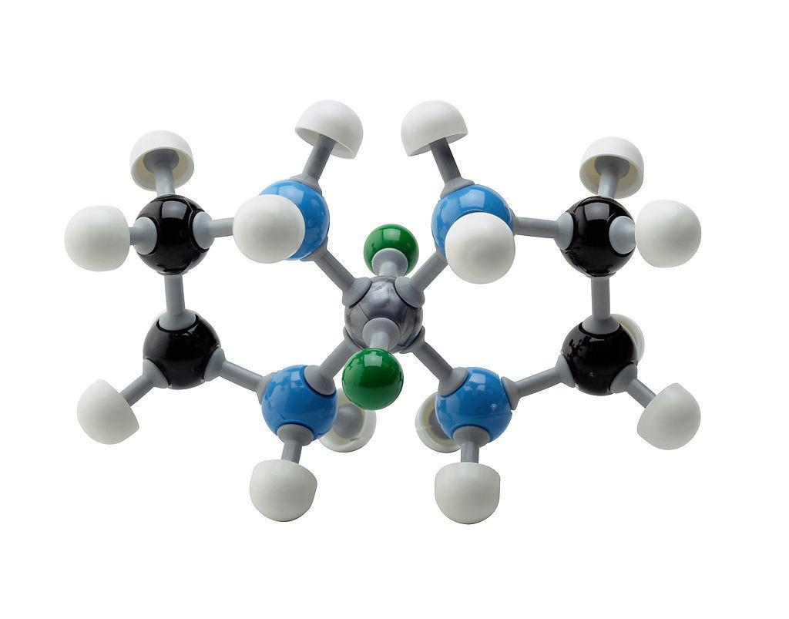
Thank you

